Slide 1
First Children’s Finance
State of Vermont’s Child Care Business Sector
May 14, 2025

Slide 2
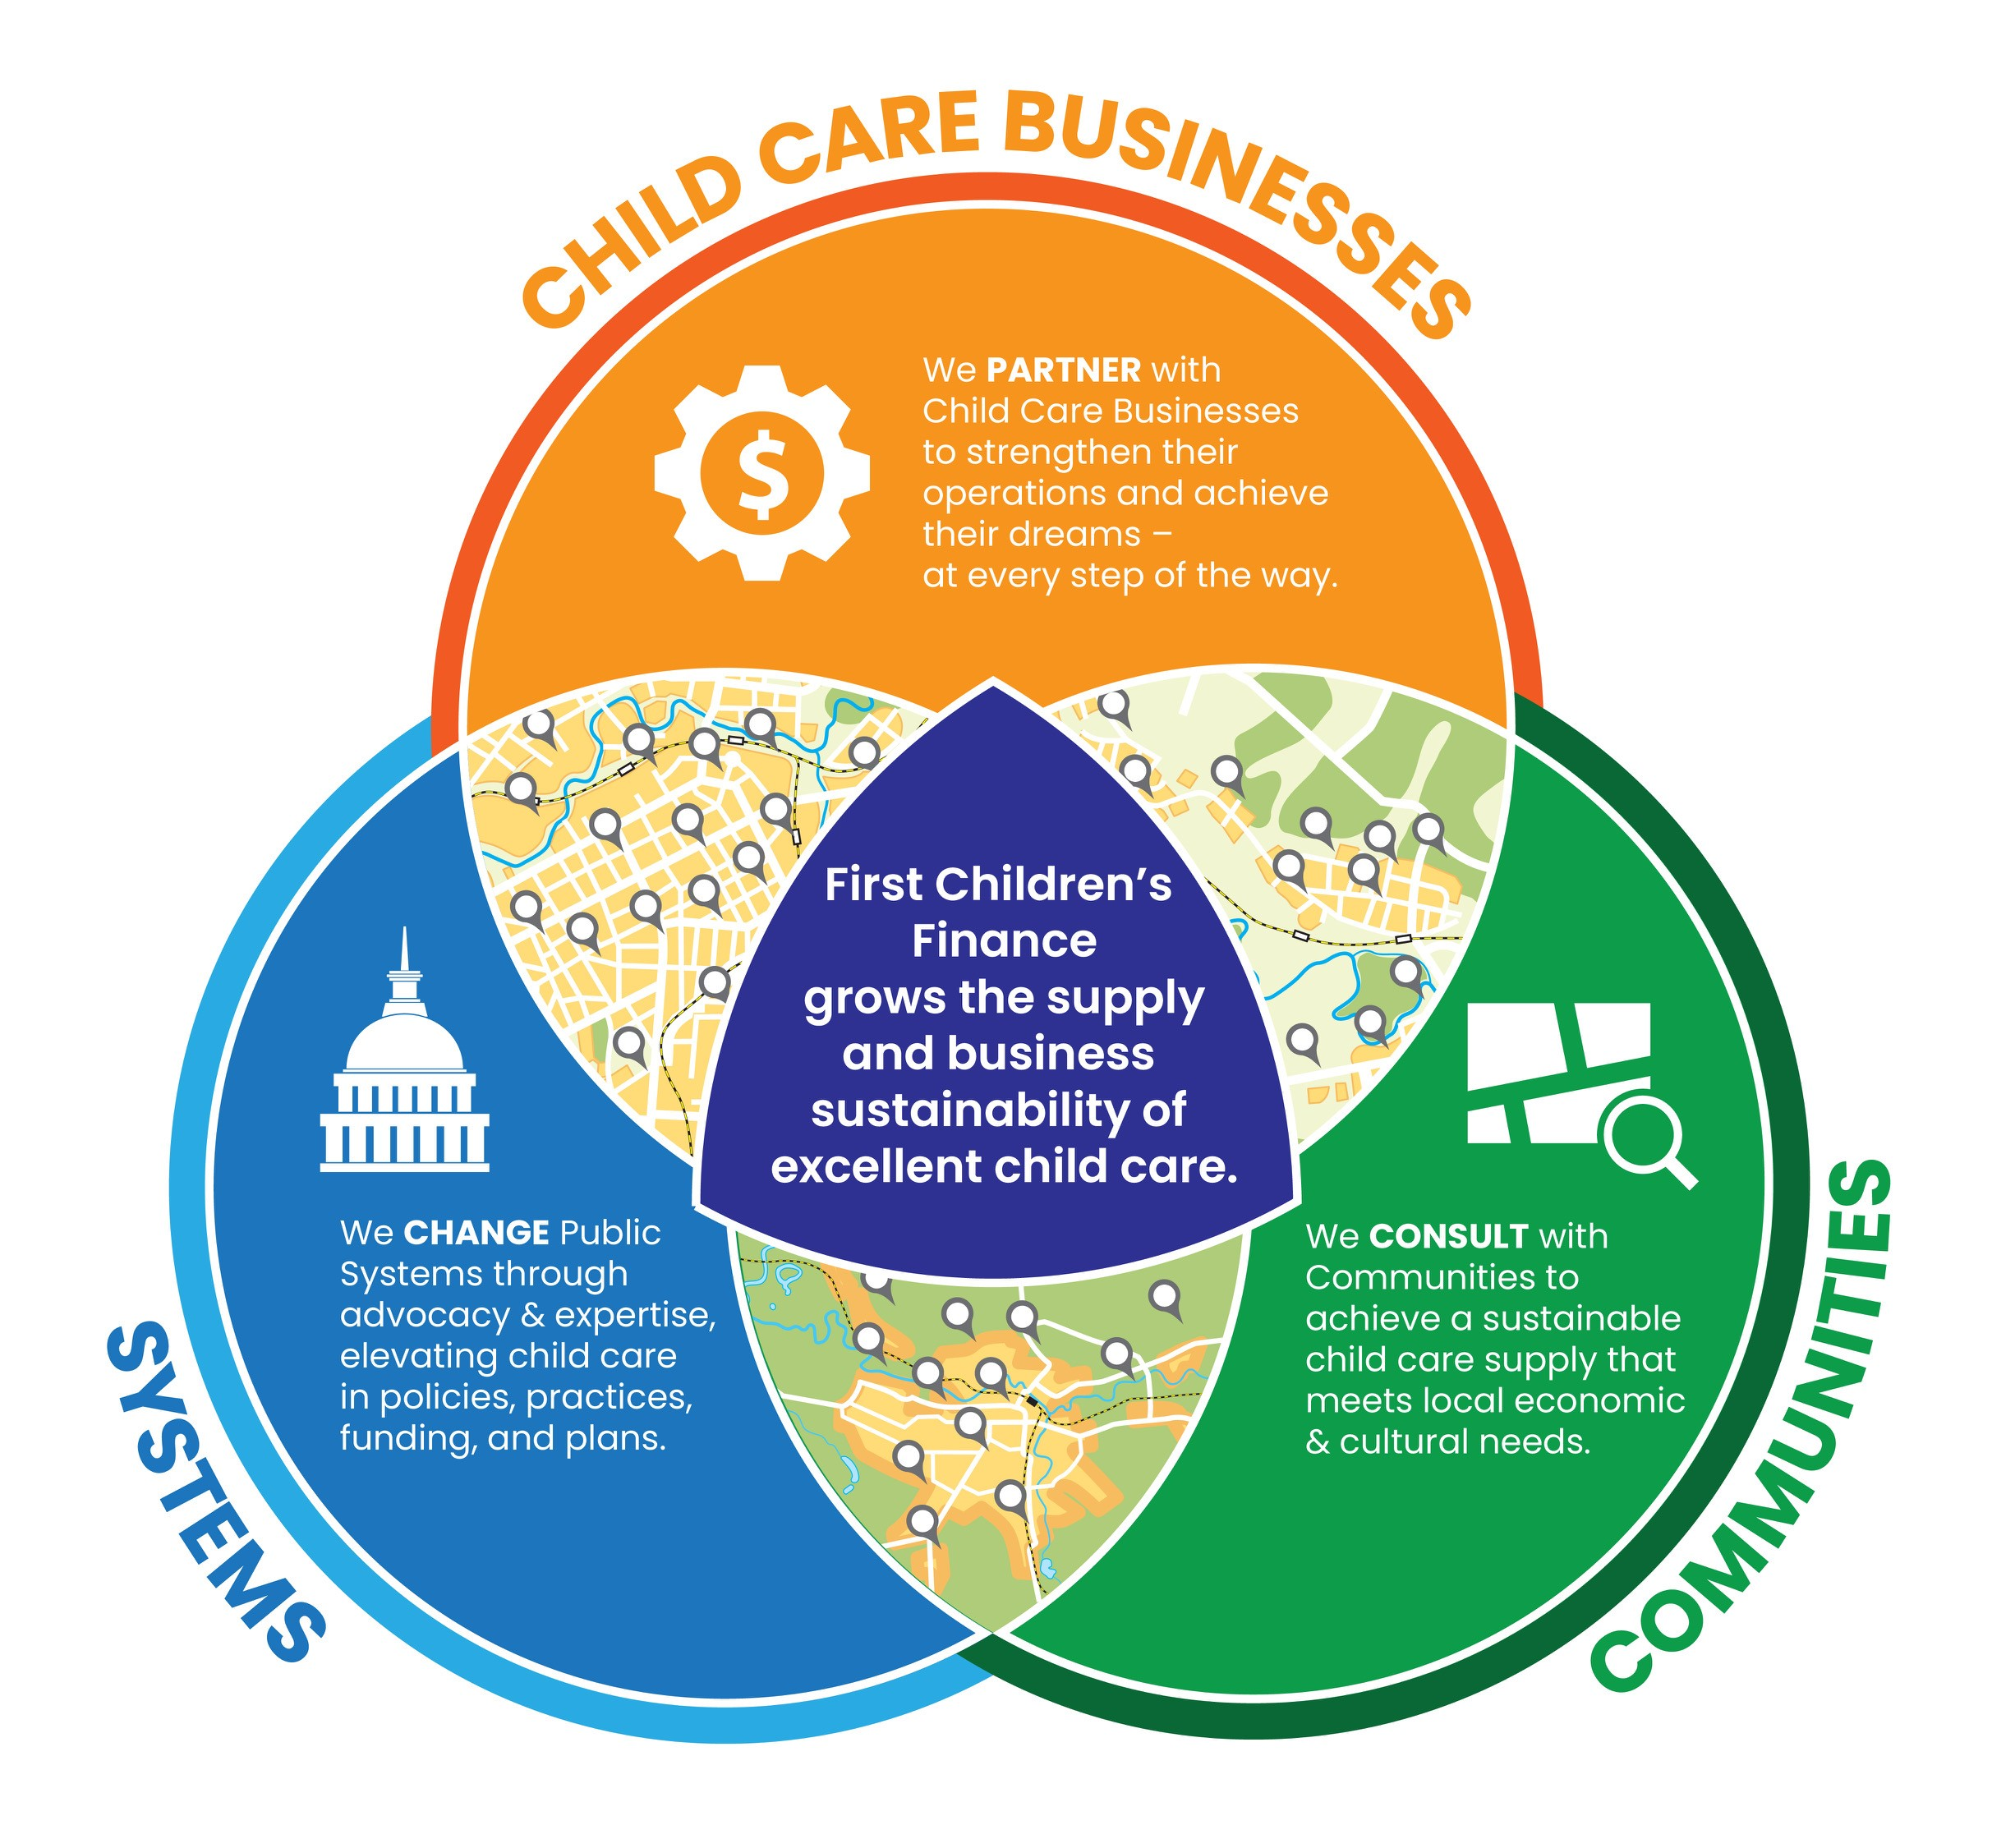
What does First Children’s Finance do?
Notes:
The mission of First Children’s Finance is to increase the supply and business sustainability of excellent child care. We do this on three levels, the Child care Business Level, Community Level, Systems Level.
Childcare BUSINESS LEVEL is where we partner with providers to strengthen their operations and achieve their dreams. We are there every step of the way.
Community Level is where we analyze the supply of child care and identify factors contributing to shortages. We consult with communities to achieve a sustainable child care supply that meets local economic and cultural needs.
FCF also does work at the systems level by aligning and leveraging existing resources to build on the sustainability of childcare. We change public systems through advocacy and expertise, elevating child care in policies, practices, funding and plans.

Slide 3
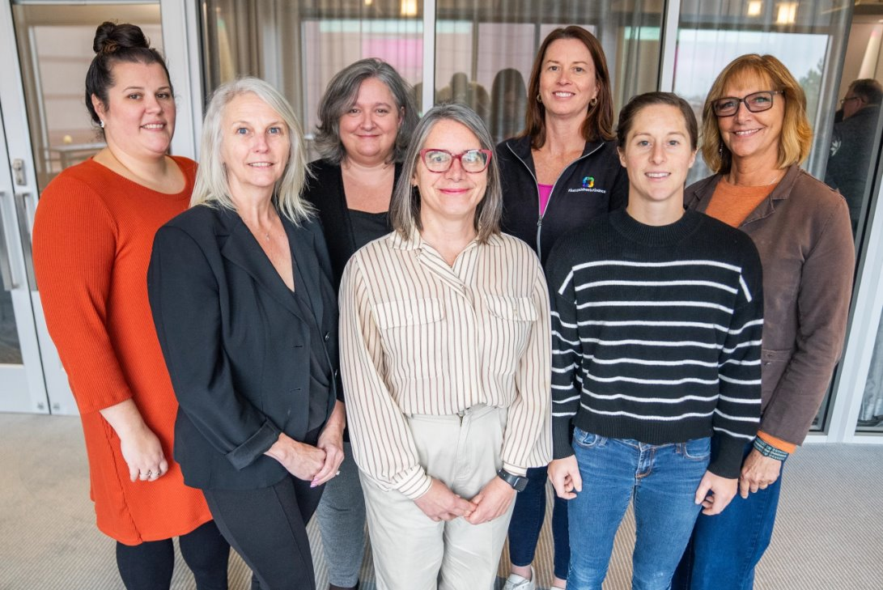
FCF VT
Samantha Collins, Business Development Specialist
Rose Morrison, Business Development Specialist
Jen Severance, Business Development Manager
Erin Roche, Director of our VT Office
Cathy Reitz, Senior Grants Specialist
Tess Weafer, Program Specialist
deb Grennon, Business Development Specialist

Slide 4
First Children’s Finance Vermont, 2023-2025
Business Technical Assistance Program
  Led 78 business trainings with 717 participants
  147 child care clients received one on one assistance
  63 financial analyses and/or business models developed
  3 years of annual surveys
  Monthly newsletter with 50% open rate
  Host and manage www.sharedservicesvt.org, a platform of national and statewide shared resources for child care
Infant/Toddler Capacity Building Grant Program
  $3.13 million awarded (with about $325,000 left to award in May 2025)
  112 projects awarded funding (with about 15-20 more expected in May 2025) to 40 FCCH and 72 Center-based projects
  751 new spaces came online in 2024 and 225 new spaces so far in 2025, with about 800 more committed for 2025
Business Planning Cohorts
  37 entrepreneurs enrolled in 3 Business Planning Cohorts nearly complete with 1-2 planned for summer
Planning Grant Project
  22 Planning Grants awarded to provide in-kind financial support for professional services needed to plan capital improvement projects
Loan Fund
  23 inquiries, 1 loan has been made in Vermont with more to come!

Slide 5
Takeaways
Since Act 76
More regulated programs
More licensed capacity at every age
More new programs than programs closed
Number of FCCH has declined since 2023, but began increasing in 2024
Capacity increases have been modest but steady
5% increase in infant capacity since March 2023

Slide 6
Takeaways
Survey participation increased by nearly 100%
More stable enrollment, financial stability unchanged
Fewer report hiring difficult
Expenses increased significantly, including payroll, benefits and food
Centers and Afterschool expect to raise tuition in 2025
Despite the increases in reimbursement and family eligibility, some programs are still struggling, especially FCCH
Many child cares rely on technology to manage the business

Slide 7
Final Takeaways
Since Act 76 there is more interest in operating a child care business
Small profit margins and years of deferred expenses mean that business owners are unprepared for financial challenges
Increased expenses coupled with continued pressure to hold prices steady may leave business owners feeling frustrated and unsure about the future
Child Care can be a sustainable business in Vermont
FCF Business Development Specialists can consult to:
Model compensation/staffing changes
Design/use space efficiently
Compare expenses to industry norms
Set effective rates and fees
Help plan for the future
Recommend financing options
Prepare grant and loan applications

Slide 8
Regulated Child Care in Vermont

Slide 9
Number of programs, by program type, 2023-2024

Slide 10
Number of regulated programs since Act 76 enacted

Slide 11
Licensed capacity, March 2023 – March 2025, by age group

Slide 12
Opens and Closures of Regulated Child Care, 2023-2025
2023
2024
2025
+75
+68
Opens
+16
-96
-50
-9
Closes

Slide 13
Results of 2025 Child Care Business Survey

Slide 14
How the respondents compare to the child care sector
 | Survey responses | Regulated programs in Vermont | Percent of population in survey
Total | 219 | 1071 | 20%
Addison | 13 | 66 | 20%
Bennington | 8 | 63 | 13%
Caledonia | 8 | 75 | 11%
Chittenden | 30 | 216 | 14%
Essex | 1 | 10 | 10%
Franklin | 25 | 89 | 28%
Grand Isle | 1 | 9 | 11%
Lamoille | 5 | 42 | 12%
Orange | 8 | 59 | 14%
Orleans | 7 | 62 | 11%
Rutland | 16 | 106 | 15%
Washington | 14 | 100 | 14%
Windham | 12 | 69 | 17%
Windsor | 12 | 105 | 11%
2025
 | Survey responses | Regulated programs in Vermont | Percent of population in survey
Total | 219 | 1071 | 20%
Afterschool | 6 | 154 | 4%
Centers | 102 | 530 | 19%
Family Child Care | 111 | 387 | 29%
Regulated programs in Vermont as of 12/31/2024

Slide 15
Who completed the survey?
5% identify as either Asian-American, Black, Hispanic, Native American or 2 or more races
1% prefer American Sign Language
2% identify as male, 1% non-binary
51% are family child care
46% are licensed centers
3% are afterschool programs only
25% have been in business 31+ years
21% opened in the past 5 years
34% programs surveyed are in Chittenden or Addison county
71% own their building or home

Slide 16
The percent reporting stable enrollment for the previous years continues to increase
Reported open spaces, average per program
Infant | Toddler | Preschool | School Age
0.19 | 0.29 | 0.71 | 0.90

Slide 17
Enrollment varies by program type, but few openings in any setting

Slide 18
Business sustainability and plans to stay in business

Slide 19
Hiring is still difficult, but continues to get easier (or be less needed)
Average Wages
 | Teacher | Assistant Teacher
Highest Wage | $24.94 | $20.05
Lowest Wage | $20.27 | $17.84
About half of child care employers offered health insurance (48%) and/or contributions to retirement (52%)
Three-quarters offered a child care discount to employees (76%).

Slide 20
Many child care businesses experienced significant increases in operating costs in 2024
9% of FCCH are behind on rent/ mortgage or making interest only/partial payments

Slide 21
Technology Management Systems are used by most child care centers and some FCCH

Slide 22
CCFAP is widely accepted, especially among centers and afterschool programs

Slide 23
Even with all the recent public investment, it’s still hard for these business owners to be optimistic about the future

